Slide 1

Arabic Fake News Detection in Egypt Using NLP
A Comparative Study of Machine Learning and Deep Learning Architectures
NLP DSAI 353| May 10, 2026

Slide 2

Abstract
6,903
This project addresses the critical issue of fake news detection in Egyptian Arabic by leveraging Natural Language Processing (NLP) techniques. We developed and compared multiple machine learning (ML) and deep learning (DL) models, utilizing both labeled and external Egyptian Arabic corpora. The study highlights the challenges posed by linguistic nuances and data imbalance, demonstrating effective preprocessing strategies and model architectures to achieve high accuracy in classification. Key findings include a comparative analysis of model performance, emphasizing the strengths and limitations of each approach, and an exploration of model interpretability to enhance trust and understanding.
Labeled Samples (Real/Fake)
2.5M
External Corpus Samples
91.2%
Peak Model Accuracy

Slide 3
Introduction
Problem Statement
Objectives
Methodology
Fake news in Egyptian Arabic poses serious societal and political challenges due to dialectal variations that hinder automated detection.
Develop robust NLP models for Egyptian Arabic fake news detection.
Data: Labeled Egyptian tweets + 2.5M external corpus.
Compare traditional ML and Deep Learning approaches.
Features: TF-IDF and custom Word2Vec.
Improve model interpretability.
Models: XGBoost, AraBERT, BiLSTM.

Slide 4

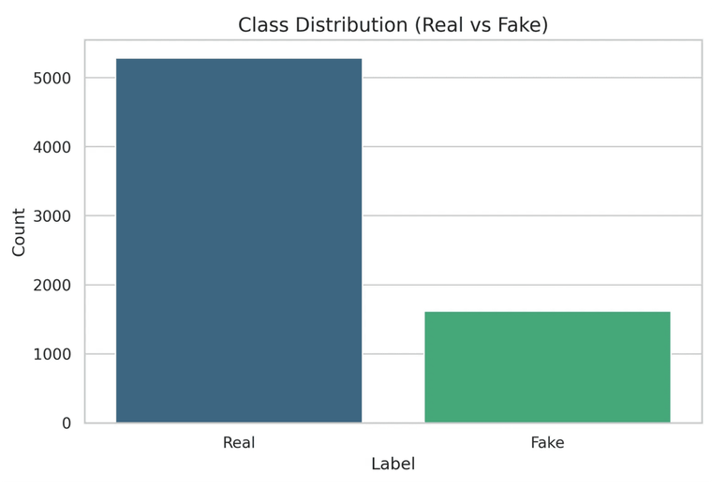
Dataset and Preprocessing
Data Source & Cleaning
Source: Egypt Fake Tweets Labeled Dataset.
Label Refinement: Removed "Uncertain" (idk) samples to focus on binary classification (Real vs. Fake).
Final Count: 6,903 high-quality labeled samples.
Arabic Text Preprocessing
Normalization of Arabic characters (e.g., Alef, Ya, Ta Marbuta).
Removal of Tashkeel (diacritics), punctuation, and numbers.
Elimination of URLs, user mentions, and hashtag symbols.
Figure 1: Class distribution showing data imbalance (Real: 5,286, Fake: 1,617)
Custom stopword removal tailored for Egyptian dialect.

Slide 5
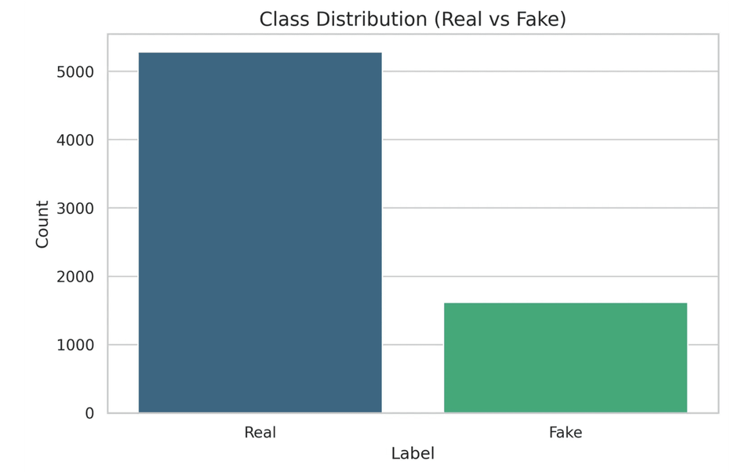
Feature Extraction and Visualization
TF-IDF Vectorization
Statistical measure evaluating word importance in a document relative to a corpus. Used for XGBoost and AraBERT baselines.
Custom Word2Vec
Trained on 2.5M Egyptian Arabic samples to capture dialect-specific semantic relationships and nuances.
Dimensionality Reduction
Latent Space Representation
PCA: Linear reduction to 2D for global variance visualization. t-SNE: Non-linear mapping to reveal local clusters in high-dimensional space.

Slide 6
Model Comparison: XGBoost vs. AraBERT
XGBoost + TF-IDF
AraBERT Fine-tuning
THEORETICAL BASIS
THEORETICAL BASIS
Extreme Gradient Boosting (XGBoost) is an optimized distributed gradient boosting library designed to be highly efficient, flexible, and portable. It implements machine learning algorithms under the Gradient Boosting framework.
AraBERT is a BERT-based pre-trained model for Arabic NLP. It leverages the Transformer architecture to capture deep bidirectional representations and contextual nuances of the Arabic language.
APPLIED EXAMPLE
APPLIED EXAMPLE
Fine-tuned on the Egyptian dialect dataset.
Utilizes statistical TF-IDF features (n-grams 1-2).
Captures semantic meaning beyond word frequency.
Handles sparse data from Arabic text effectively.
Requires GPU acceleration for efficient training.
Fast training and inference cycles.
90.01% Accuracy
91.24% Accuracy

Slide 7

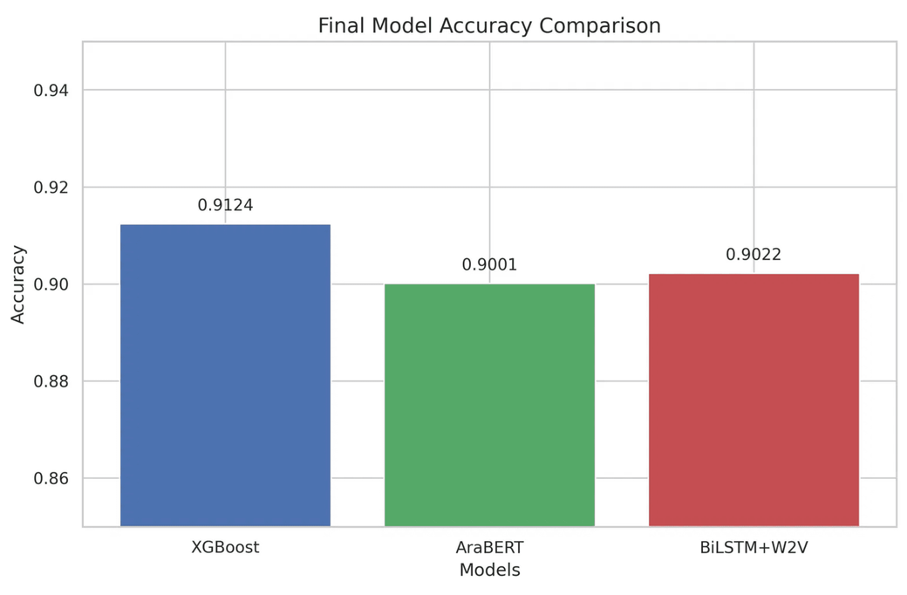
Model Comparison: BiLSTM & Performance Summary
BiLSTM + Custom Word2Vec
Theoretical Basis & Application: Bidirectional LSTMs capture context from both directions; used with a custom Word2Vec trained on Egyptian Arabic to capture dialect semantics.
Performance Insights
XGBoost: Leading performance with 91.24% accuracy.
AraBERT: Strong contextual understanding (90.01%).
BiLSTM: Robust sequential modeling (90.22%).
Figure: Final Model Accuracy Comparison

Slide 8

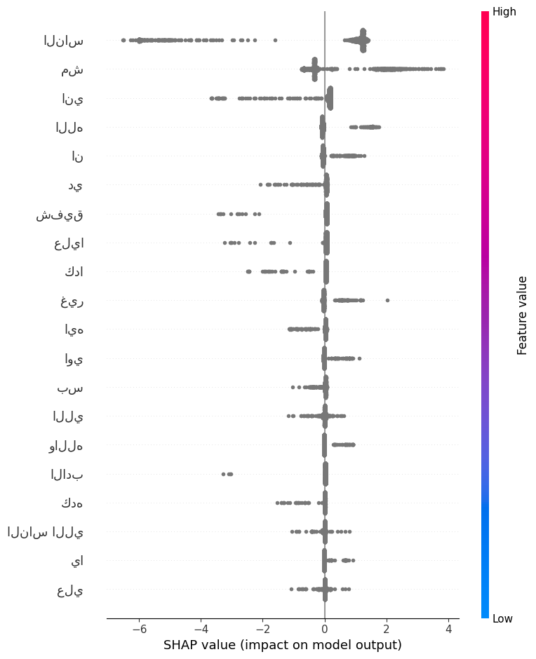
Interpretability and Explainability
[SHAP Beeswarm/Summary Plot Visualization]
SHAP Methodology
SHAP (SHapley Additive exPlanations) leverages game theory to assign each feature an importance value for a particular prediction, ensuring local accuracy and consistency.
Application to XGBoost
By applying SHAP to the XGBoost model, we identify key linguistic markers and keywords that drive the classification of Egyptian tweets as 'Real' or 'Fake'.
Figure: Global feature importance revealing top keywords influencing model decisions.
Key Insights:
Identifies high-impact dialectal terms.
Visualizes positive/negative feature contributions.
Enhances model transparency and user trust.

Slide 9
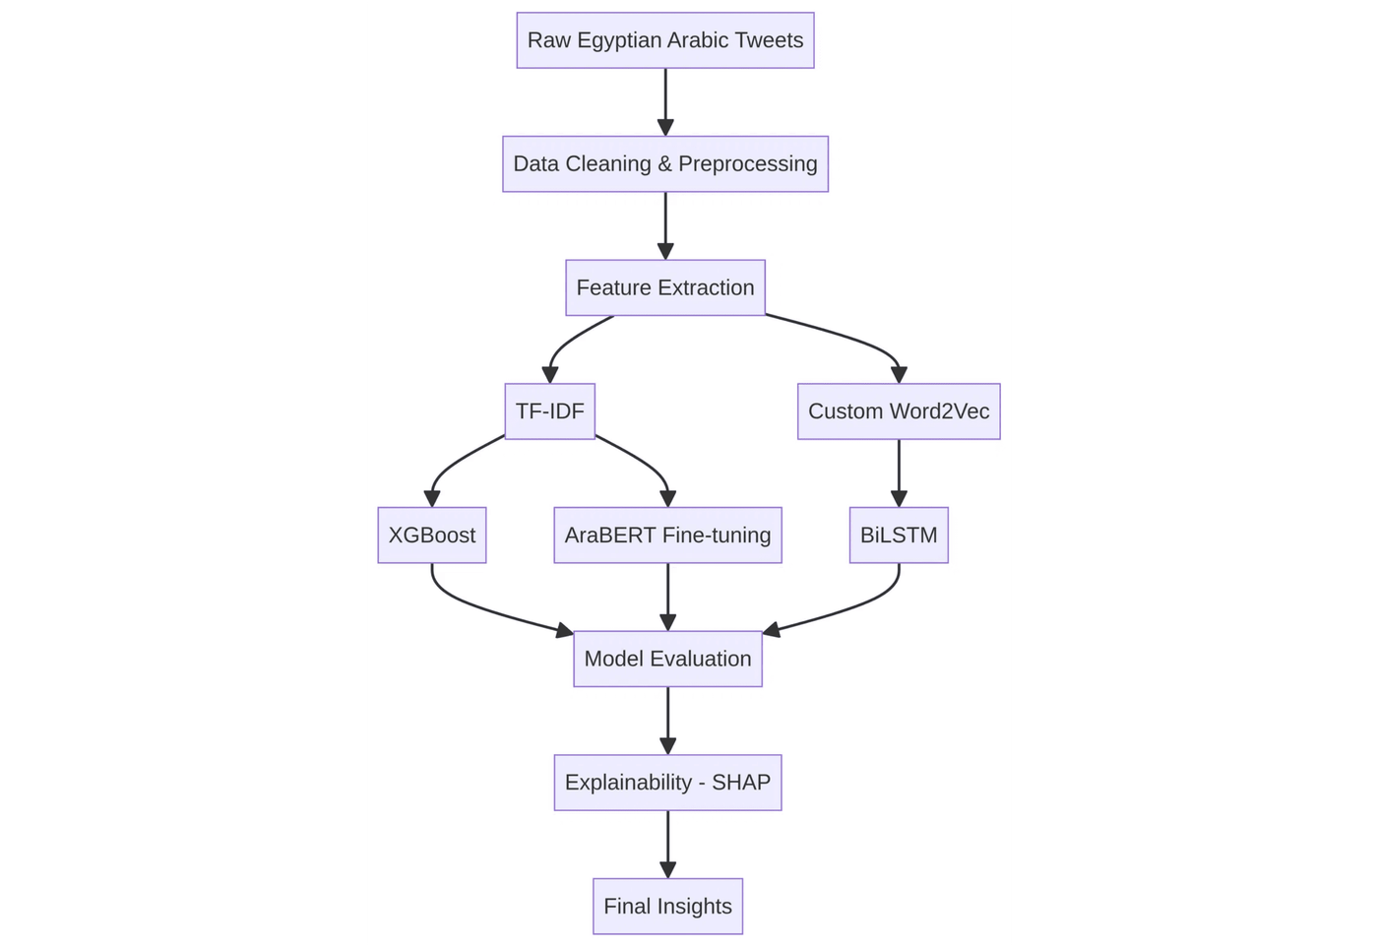
Project Workflow
End-to-End Pipeline
The workflow begins with raw Egyptian Arabic tweet collection, followed by rigorous dialect-specific preprocessing.
Features are extracted using both statistical (TF-IDF) and semantic (Word2Vec) methods before being fed into diverse model architectures.
The final stage involves comprehensive evaluation and interpretability analysis using SHAP values.

Slide 10
Conclusion and Future Work
Summary of Findings
Future Directions
Model Efficacy: Successfully compared XGBoost, AraBERT, and BiLSTM for Egyptian Arabic fake news detection.
Multi-modal Detection: Integrating image and metadata analysis for more robust verification.
Performance: XGBoost achieved a peak accuracy of 91.24%, demonstrating the power of statistical features in dialectal contexts.
Real-time Inference: Developing lightweight models for live social media monitoring.
Dataset Expansion: Addressing class imbalance through advanced data augmentation and active learning.
Interpretability: SHAP analysis provided crucial insights into model decision-making, identifying key dialectal markers.

